Slide 1

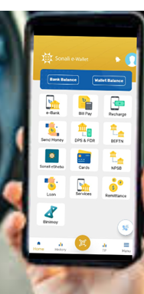

TOLL COLLECTION
WITH SONALI E-WALLET
A Cashless Smart Toll Payment Solution
Presented by:
Sonali Bank PLC
www.sonalibank.com.bd

Slide 2
INTRODUCTION
Sonali e-Wallet is a smart banking solution that empowers users to register and manage their toll payments seamlessly. When a vehicle equipped with an Electronic Toll Collection (ETC) system approaches a toll plaza, a payment request is automatically triggered and processed via the Sonali e-Wallet. The system promptly confirms the payment from the customer’s account, ensuring a fast and efficient passage.
This integration supports the broader objective of developing a cashless, digital toll infrastructure, while also enhancing customer convenience, operational efficiency, and transactional transparency.
SONALI BANK PLC

Slide 3
COMMITMENT OF SERVICES
· Self-Payment Service of Customers
· 24x7 services
· Online & sonali e-wallet
· API based Integrations
· Automatic Reconciliation
· Regular Settlement & confirm a-challan / bank account next day
· Real-time monitoring panel
SONALI BANK PLC

Slide 4
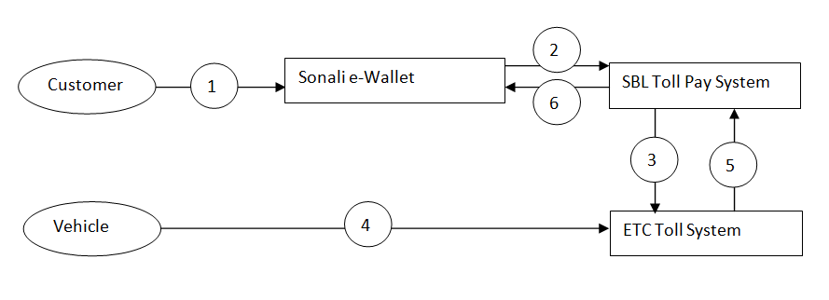
INTEGRATION WITH SONALI E-WALLET
SONALI BANK PLC

Slide 5
STEPS OF FLOW BUSINESS OPERATION
Registration:
Sonali e-Wallet customers can register to ensure sufficient balance for making toll payments via their Sonali e-Wallet account.
Registration Request Submission:
The Sonali e-Wallet system sends the registration request to the ETC Toll Collection System through the Sonali Bank Toll Collection System.
a. The system first checks vehicle details.
b. Then, it sends the registration request.
Verification and Confirmation:
The ETC Toll Collection System verifies the registration data received from Sonali e-Wallet and confirms the registration to Sonali Bank.
SONALI BANK PLC

Slide 6
STEPS OF FLOW BUSINESS OPERATION
De-registration (if applicable):
If an existing user wants to de-register, the de-registration request is sent from the Sonali e-Wallet system to the ETC Toll Collection System, which then confirms the de-registration.
Toll Passage and Payment Request:
When a registered vehicle passes through the toll gate, the ETC Toll Collection System sends a payment request to the Sonali Bank Toll Collection System.
Payment Confirmation and Vehicle Passage:
Sonali Bank confirms the payment to the ETC system. Once confirmed, the ETC system allows the vehicle to pass.
SONALI BANK PLC

Slide 7
STEPS OF FLOW BUSINESS OPERATION
Settlement and Reconciliation (T+1):
On the next business day (T+1), Sonali Bank reconciles all transactions with the ETC Toll Collection System for the previous day and completes settlement. Upon completion, Sonali Bank transfers the funds to the ETC Collection Bank Account via BEFTN or A-Challan.
Transaction Reversal:
If any transaction needs to be reversed, the ETC Toll System sends a reversal request to the Sonali Bank Toll Collection System. Sonali e-Wallet verifies the request and confirms the reversal accordingly.
SONALI BANK PLC

Slide 8
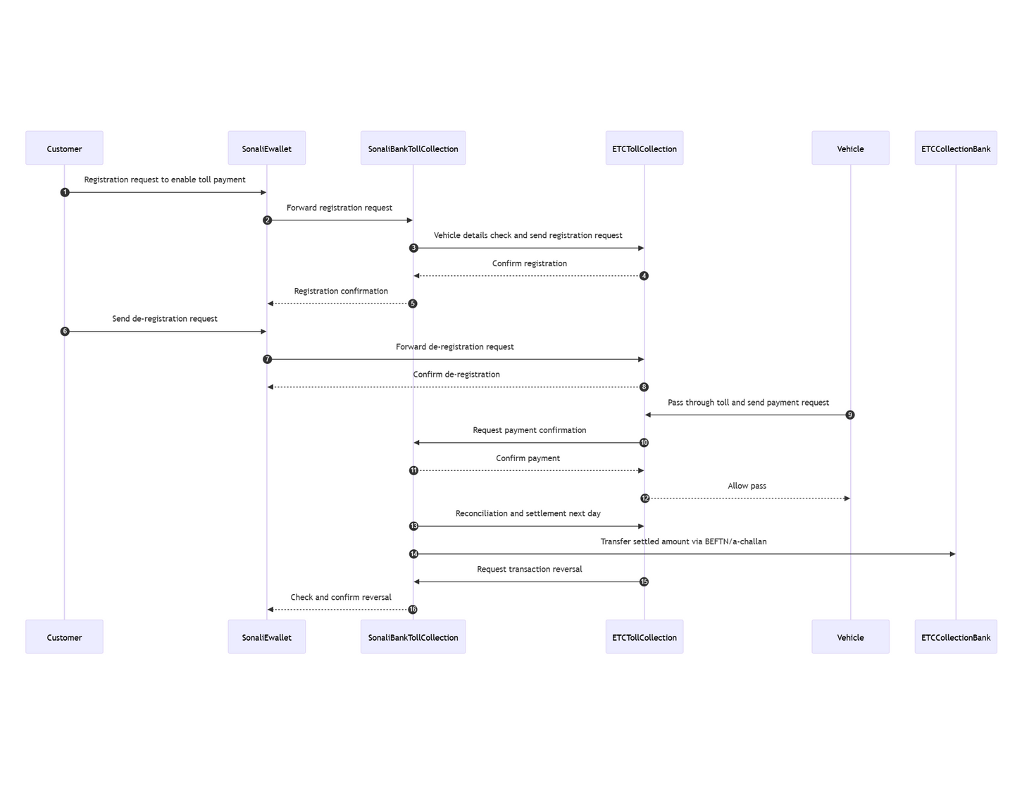
STEPS OF FLOW SEQUENTIAL DIAGRAM
SONALI BANK PLC

Slide 9
TECHNICAL STRENGTH
High- Availability
Load Balancers
WAF
REST API Integration
Web-based Applications
Directly API based integrations
Automated Settlement & Reconciliation
VPN Connectivity
24x7 Customer Care
SONALI BANK PLC

Slide 10
RECONCILIATION WITH ETC SYSTEM
Registration and payment transaction through REST API
Network connectivity (VPN/ IP white list)
Reconciliation- by shared csv file shared by sftp/portal through VPN/over the.
Daily fund settlement completed t+1 through BEFTN/a-Challan
SONALI BANK PLC

Slide 11
Q& A
SONALI BANK PLC

Slide 12
THANKS’
SONALI BANK PLC

